Slide 1
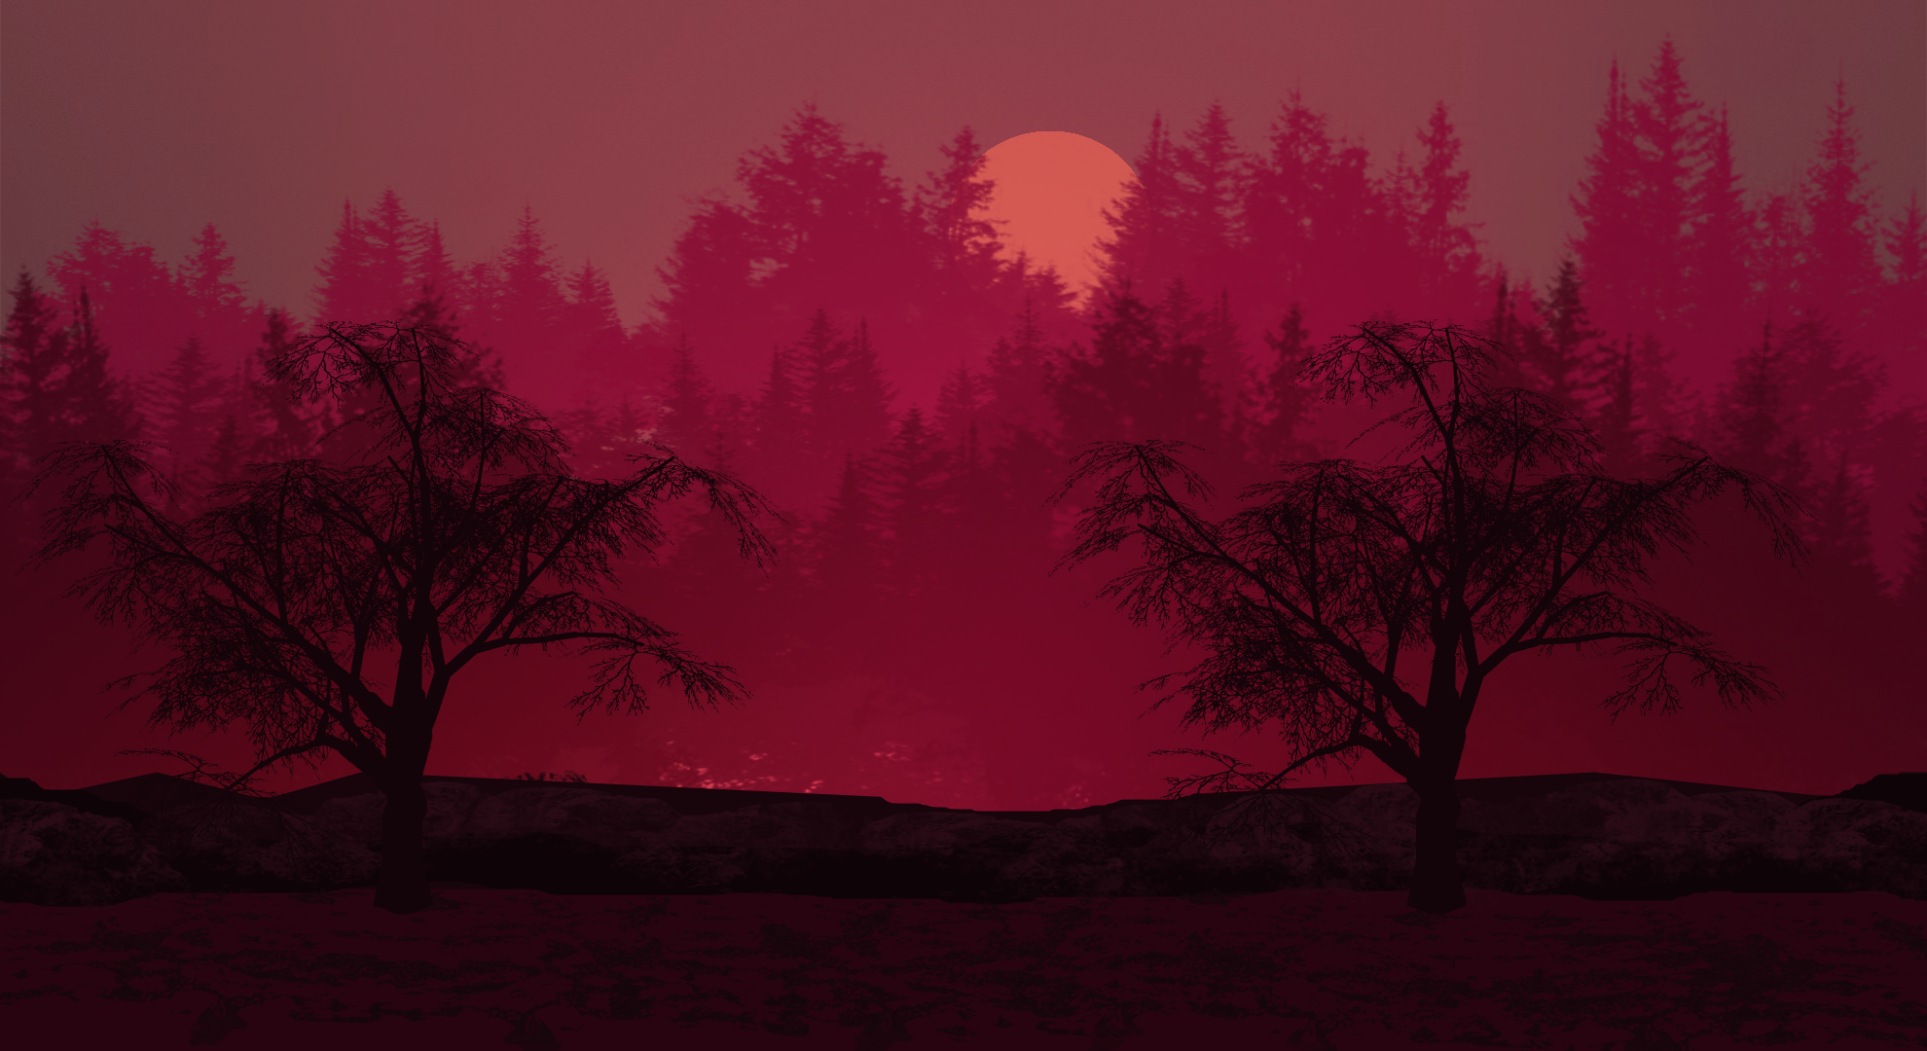

Game Programming Project by Juan Arizpe Vega
About
Genre: Horror
Type: 2D Side Scroller
“The Story of Parallax” Lets you explore the strange world of Parallax filled with creatures of the night that will keep you in the dark

Slide 2
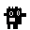
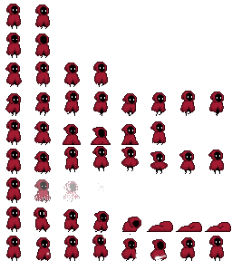
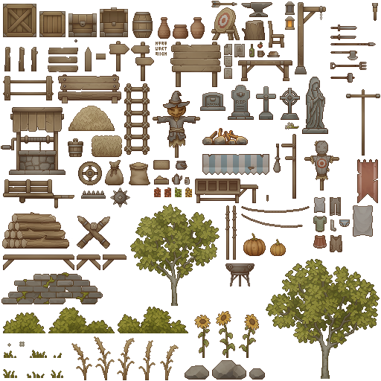
Game Programming Project by Juan Arizpe Vega
About
Genre: Horror
Type: 2D Side Scroller
“The Story of Parallax” Lets you explore the strange world of Parallax filled with creatures of the night that will keep you in the dark
Explore through the levels to find the exit before it gets too dark
Avoid
Find the Exit

Slide 3

About
Genre: Horror
Type: 2D Side Scroller
“The Story of Parallax” Lets you explore the strange world of Parallax filled with creatures of the night that will keep you in the dark
Objective
Explore through the levels to find the exit before it gets too dark
Avoid
Find the Exit
Keys:
Spacebar

Slide 4
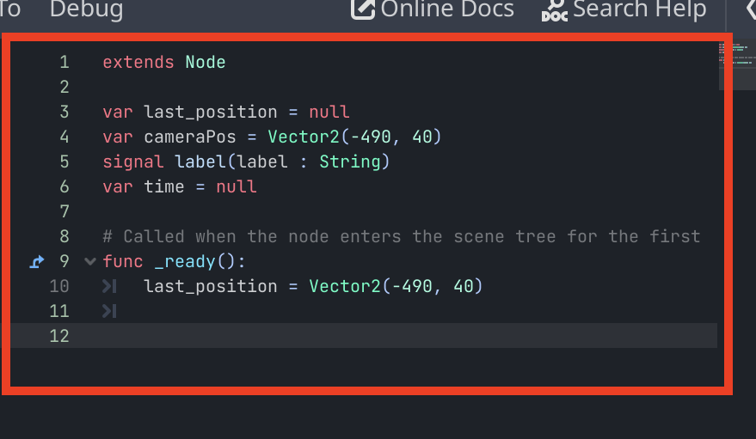
How to Play
Step 1: Make a Script
Keys:
Spacebar

Slide 5
Keys:
Spacebar
Tutorial
Loading a script through multiple scenes in Godot in 3 easy steps

Slide 6
Keys:
Spacebar
Tutorial
Step 1: Make a Script

Slide 7
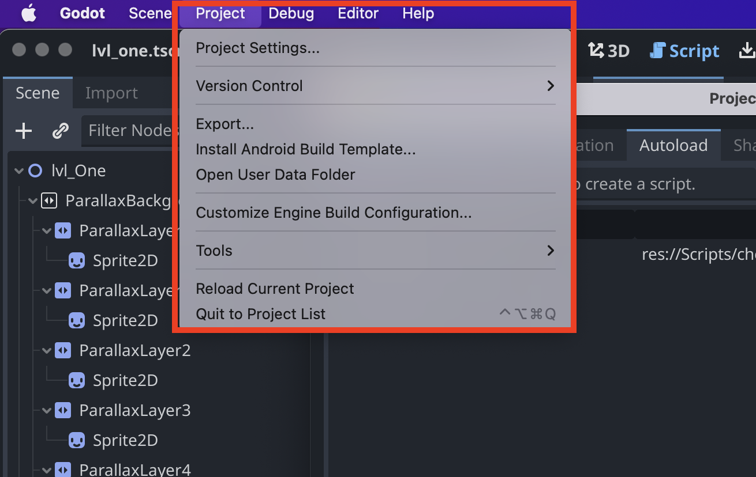
Keys:
Spacebar
Tutorial
Step 2: Go to settings

Slide 8
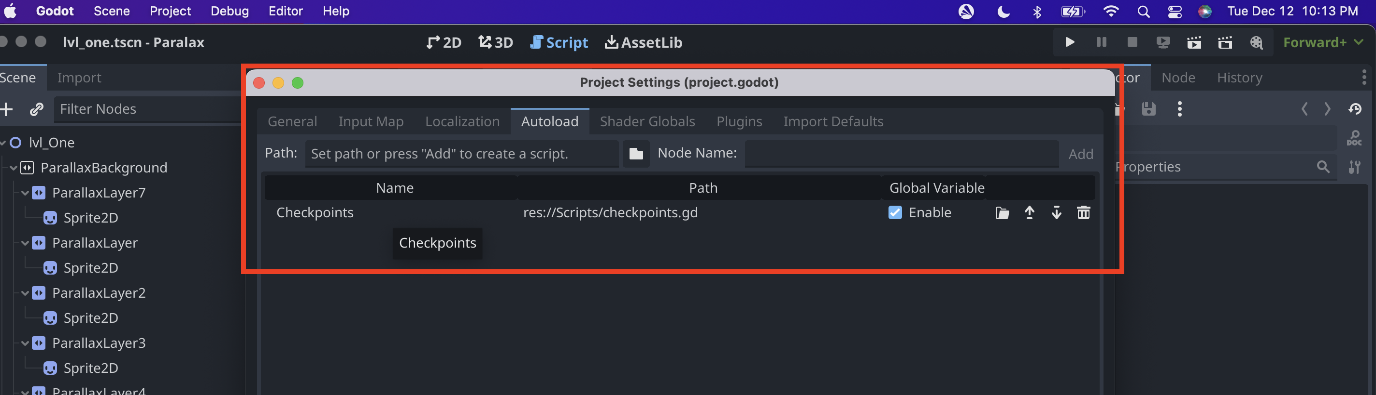
Keys:
Spacebar
Tutorial
Step 3: Add file to Autoload

Slide 9
Timeline
Prototype level in Godot
Added additional details and bug fix
Idea over the summer
Prototype level crashed
Summer
End of Semester
Testing out features
Prototype in Greenfoot
Additional Features: level 2 & difficulty
Level One implemented

Slide 10
Keys:
Spacebar
What Have I learned?
Auto scripts
Nodes
Scenes
Parallax
Animation
Lights
Camera
Signals
Collison boxes
Timers
Tile Maps
Sprites
Margins

Slide 11
Prototype level in Godot
Added additional details and bug fix
Idea over the summer
Prototype level crashed
Summer
End of Semester
Testing out features
Prototype in Greenfoot
Additional Features: level 2 & difficulty
Level One implemented
Thank you!
Comments?
Questions?
Concerns?

